Slide 1
CSE7302 - INTERNSHIP Review-1 Presentation Full Stack Development
Student Details
Name | Nikhita L D
Roll No | 20221CSE0696
Section | 8CSE09
Under the Supervision of,
Mr. H. Senthil Kumar
Professor / Associate Professor / Assistant Professor
Presidency School of CSE
Presidency University
Name of the Program: B.Tech CSE
Name of the HoD: Dr.Asif Mohammed
Name of the Program Internship Coordinator: Dr Balakrishnan , Dr Shakthi
Name of the School Internship Coordinator: Dr. Md Ziaur Rahman

Slide 2
Content
About Company or Organization : Rail Wheel Factory (RWF) is a Government of India unit under Indian Railways, located in Yelahanka, Bengaluru
Working domain or the technology : Full Stack Web Development
About your team and reporting Manager : Mr Apparao
Challenges Faced in Internship : I learned a new error and about Full stack
Objectives of the work : To implement CRUD operations (Add, View, Update, Delete)
Internship Roadmap
Github Link : https://github.com/shivanandashetty

Slide 3
About Company or Organization
Rail Wheel Factory (RWF) is a Government of India organization under the Ministry of Railways
Located in Yelahanka, Bengaluru
Focuses on modernization and digitalization of internal system
Uses software and IT solutions to improve data management and efficiency
Products & Services
Provides manufacturing and maintenance support to Indian Railways
Offers technical and engineering services for railway infrastructure
Uses digital systems for data management and internal operations
Supports automation and software-based solutions inside the organization

Slide 4
About Company or Organization
Clients & Impact
Primary client: Indian Railways
Supports different departments with software and digital systems
Plays a key role in improving efficiency and data management
Supports modernization and digital record management inside the organization

Slide 5
Working domain or the technology
Domain: Full Stack Web Development
Frontend: ReactJS for building user interface
Backend: FastAPI (Python) for API and business logic
Database: MS SQL Server for data storage and management

Slide 6
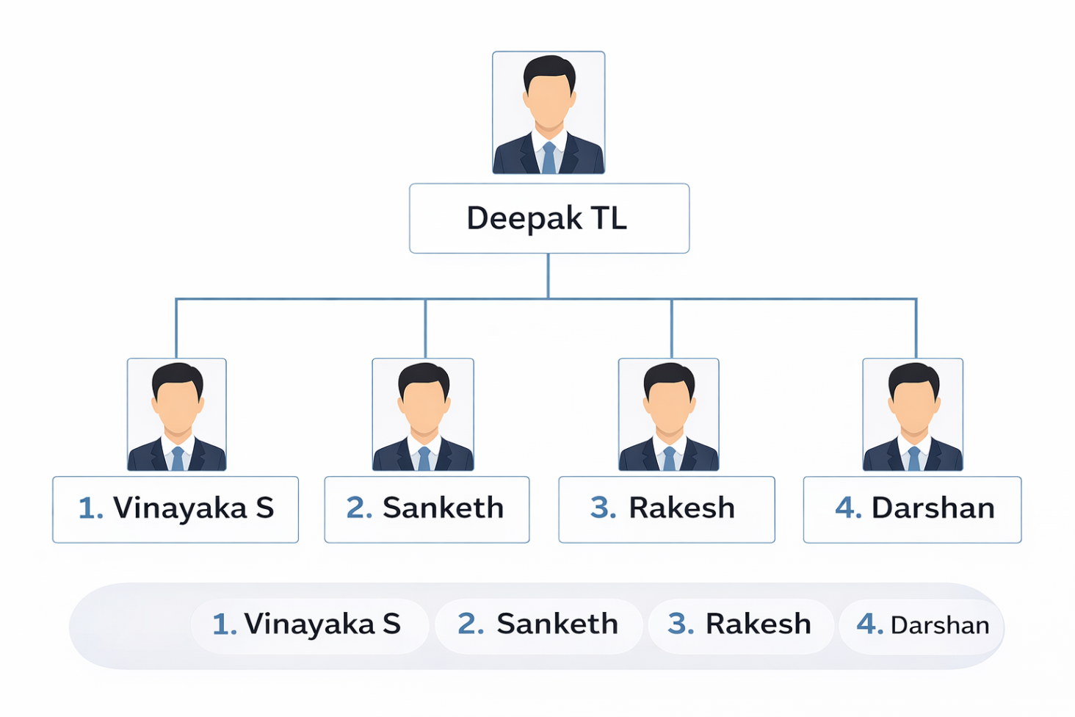
About your team and reporting Manager
Mr. Apparao
1. Shivananda
2.Veeresh M
3. Nikhitha L D
4. Shivaprasad
1. Shivananda
2.Veeresh M
3. Nikhitha L D
4. Shivaprasad

Slide 7
Objectives of the work
To develop a web-based application
To connect ReactJS frontend with FastAPI backend
To implement CRUD operations (Add, View, Update, Delete)
To store and manage data using MS SQL Server

Slide 8
Internship Road Map
Note: Write in the below table what u will be achieving in each review
Review 1
Analysis and researched about the Full Stack Development and Work flow and Libraries are Used
Review 2
Review 3
Review 4
Final Review

Slide 9
Github Link
https://github.com/nikhitha-ld

Slide 10
Q&A

Slide 11
Thank you !!

